Slide 1
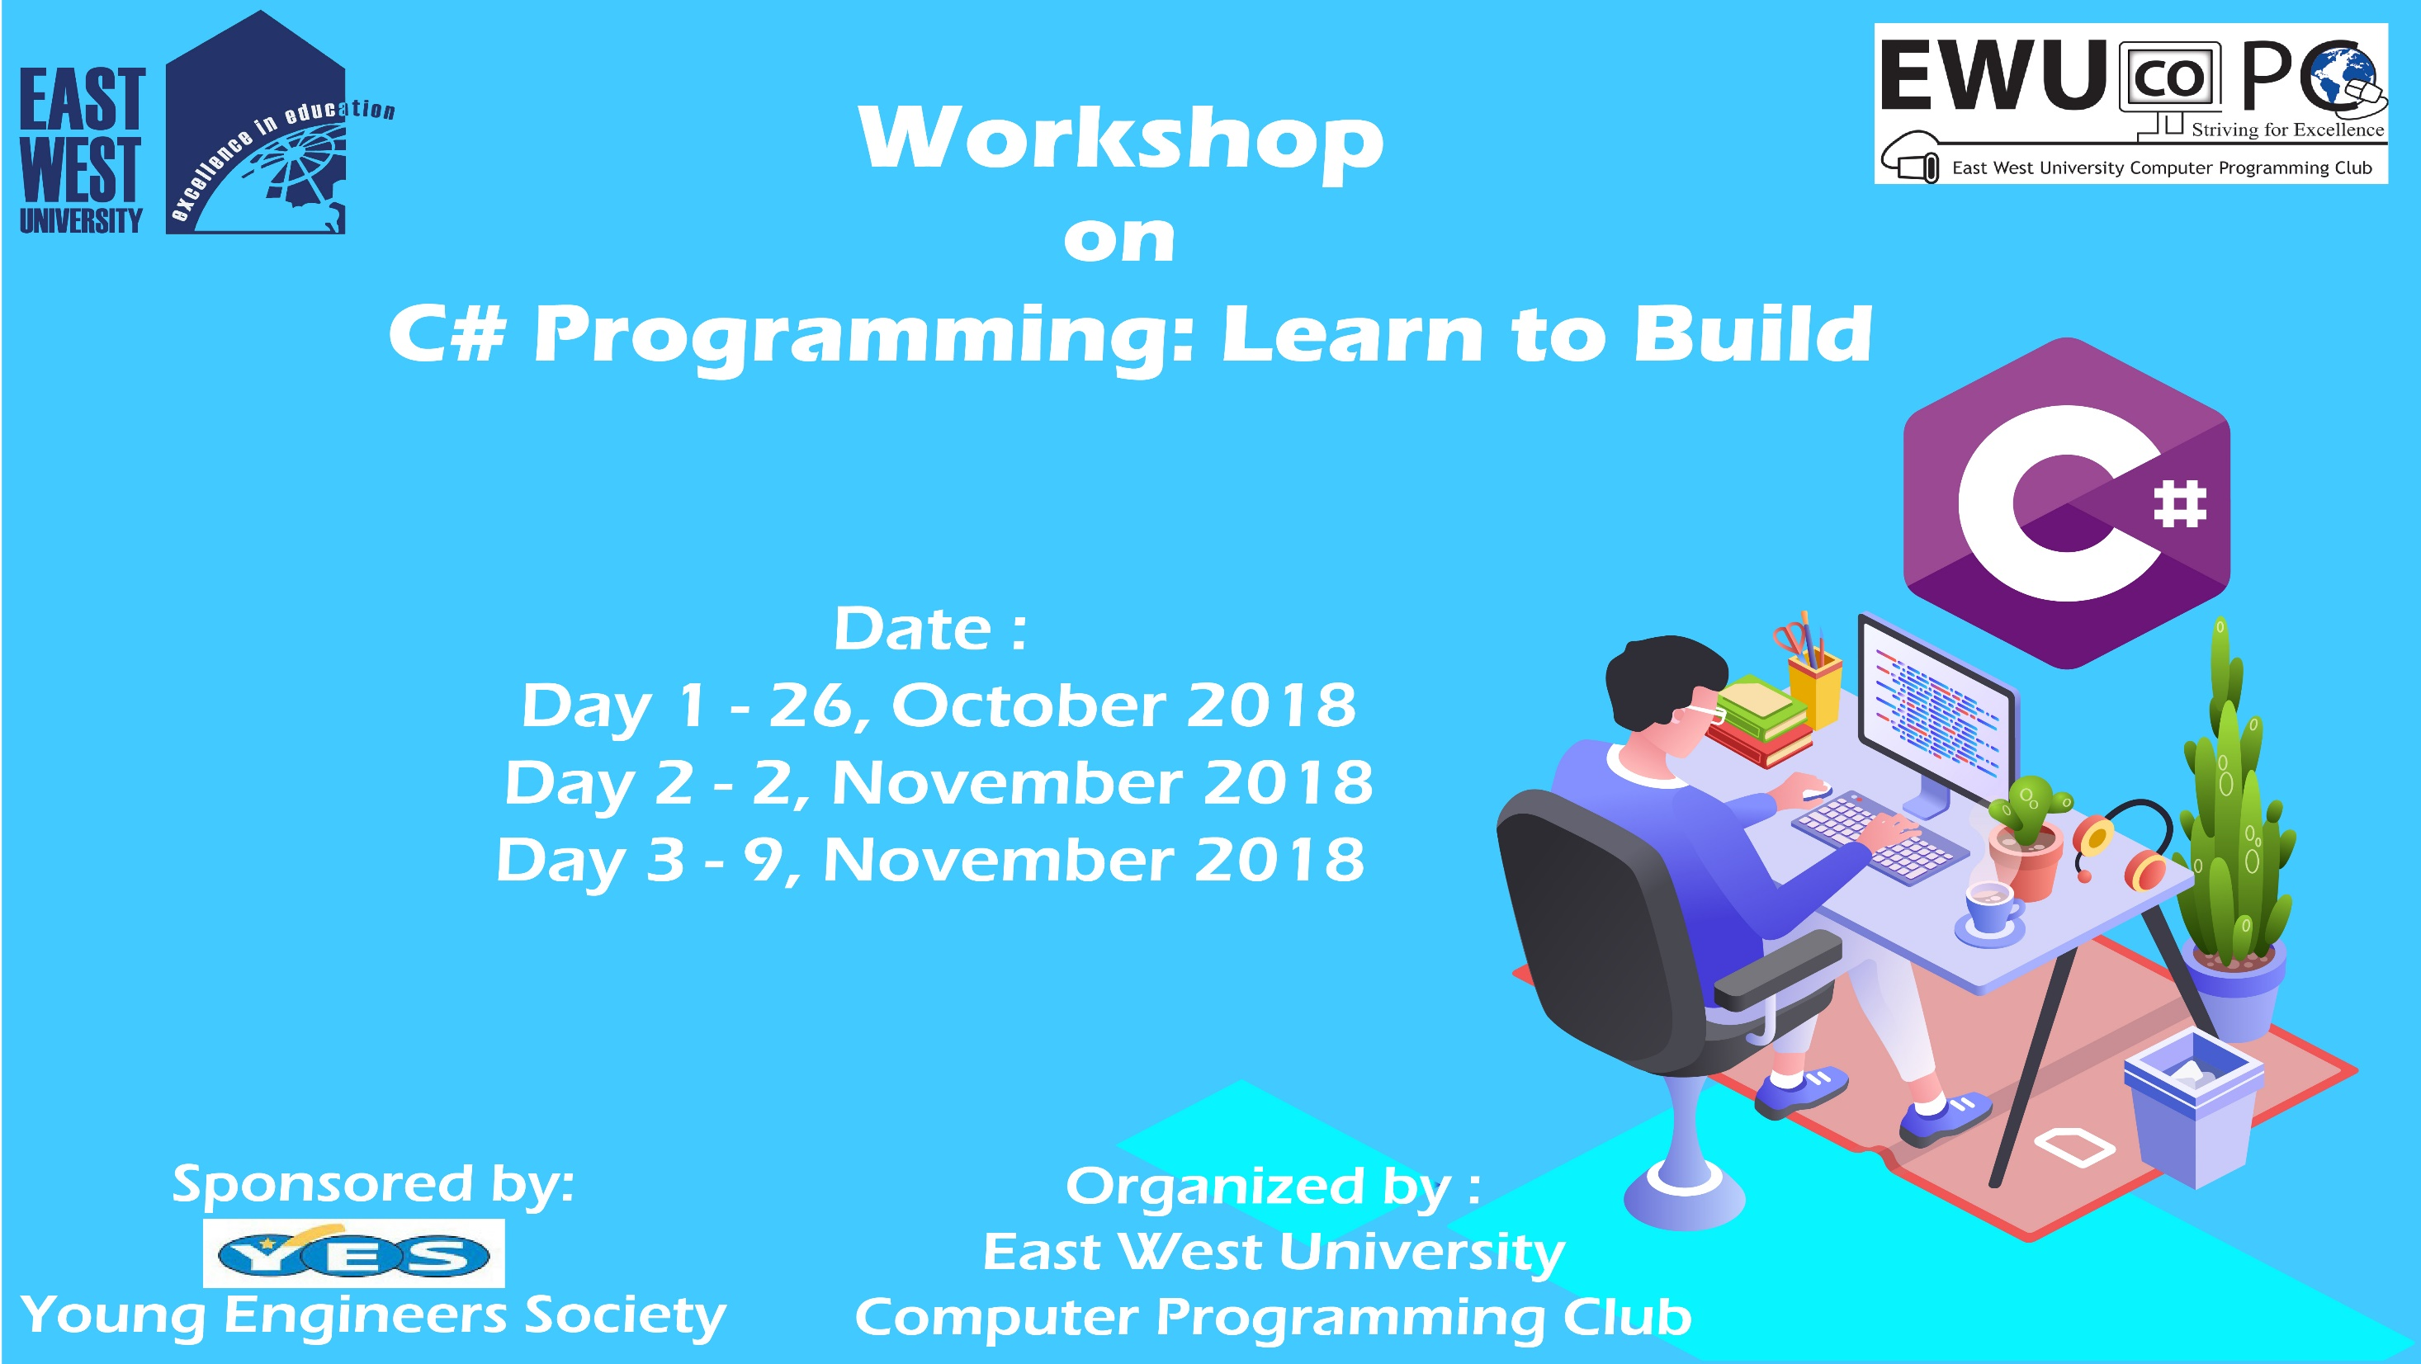

Slide 2
C# Day 1 Lecture4: Data Type

Slide 3
Data Type: Integer
using System;
namespace dataType
{
class Program
{
static void Main(string[] args)
{
int intValue = 100;
Console.WriteLine(intValue);
Console.Read();
}
}
}

Slide 4
Data Type: Double
using System;
namespace dataType
{
class Program
{
static void Main(string[] args)
{
double doubleValue = 100.100;
Console.WriteLine(doubleValue);
Console.Read();
}
}
}

Slide 5
Data Type: Decimal
using System;
namespace dataType
{
class Program
{
static void Main(string[] args)
{
decimal longDouble = 10000.1000m;
Console.WriteLine(longDouble);
Console.Read();
}
}
}

Slide 6
Data Type: Character
using System;
namespace dataType
{
class Program
{
static void Main(string[] args)
{
char charValues = 'a';
Console.WriteLine(charValue);
Console.Read();
}
}
}

Slide 7
Data Type: Initialize Type
using System;
namespace dataType
{
class Program
{
static void Main(string[] args)
{
int intValue;
intValue =new int();
Console.WriteLine(intValue);
Console.Read();
}
}
}

Slide 8
This slide is provided as a course material in the workshop named “Workshop on C# Programming: Learn to Build”.
Organized by-
East West University Computer Programming Club (EWUCoPC)
Prepared by- Jannat Binta Alam
Campus Ambassador
Young Engineers Society (YES)
E-mail: jannat.cse.ewu@gmail.com

